Slide 1
Modeling and Notations
Software Architecture
Lecture 10

Slide 2
Continuing Our Survey
Generic approaches
  Natural language
  PowerPoint-style modeling
  UML, the Unified Modeling Language
Early architecture description languages
  Darwin
  Rapide
  Wright
Domain- and style-specific languages
  Koala
  Weaves
  AADL
Extensible architecture description languages
  Acme
  ADML
  xADL

Slide 3
Continuing Our Survey
Generic approaches
  Natural language
  PowerPoint-style modeling
  UML, the Unified Modeling Language
Early architecture description languages
  Darwin
  Rapide
  Wright
Domain- and style-specific languages
  Koala
  Weaves
  AADL
Extensible architecture description languages
  Acme
  ADML
  xADL

Slide 4
Early Architecture Description Languages
Early ADLs proliferated in the 1990s and explored ways to model different aspects of software architecture
  Many emerged from academia
  Focus on structure: components, connectors, interfaces, configurations
  Focus on formal analysis
  None used actively in practice today, tool support has waned
    Ideas influenced many later systems, though

Slide 5
Darwin
General purpose language with graphical and textual visualizations focused on structural modeling of systems
Advantages
  Simple, straightforward mechanism for modeling structural dependencies
  Interesting way to specify repeated elements through programmatic constructs
  Can be modeled in pi-calculus for formal analysis
  Can specify hierarchical (i.e., composite) structures
Disadvantages
  Limited usefulness beyond simple structural modeling
  No notion of explicit connectors
    Although components can act as connectors

Slide 6
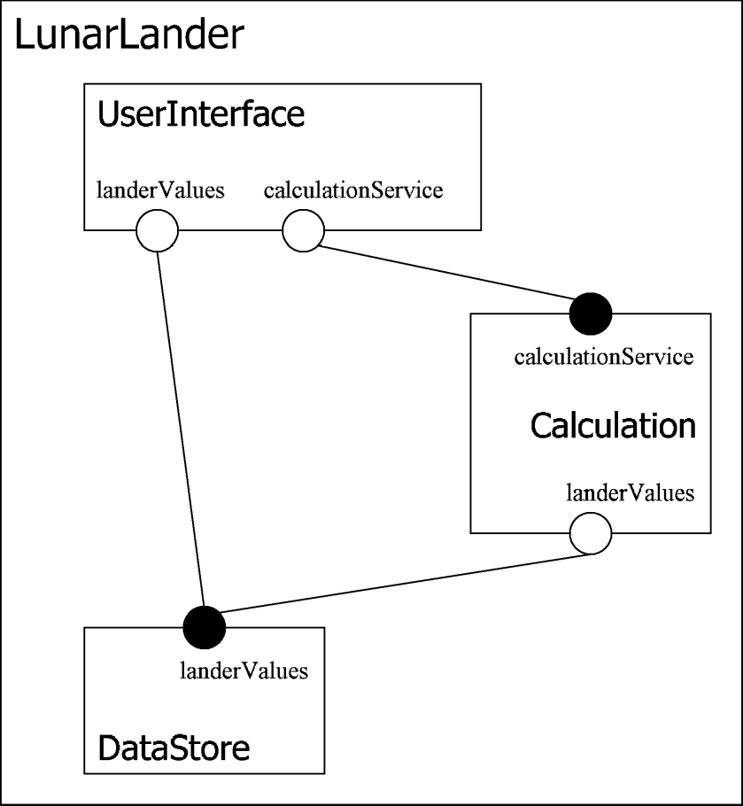
Darwin Example
component DataStore{
provide landerValues;
}
component Calculation{
require landerValues;
provide calculationService;
}
component UserInterface{
require calculationService;
require landerValues;
}
component LunarLander{
inst
U: UserInterface;
C: Calculation;
D: DataStore;
bind
C.landerValues -- D.landerValues;
U.landerValues -- D.landerValues;
U.calculationService -- C.calculationService;
}
Canonical Textual Visualization
Graphical Visualization
Software Architecture: Foundations, Theory, and Practice; Richard N. Taylor, Nenad Medvidovic, and Eric M. Dashofy; © 2008 John Wiley & Sons, Inc. Reprinted with permission.

Slide 7
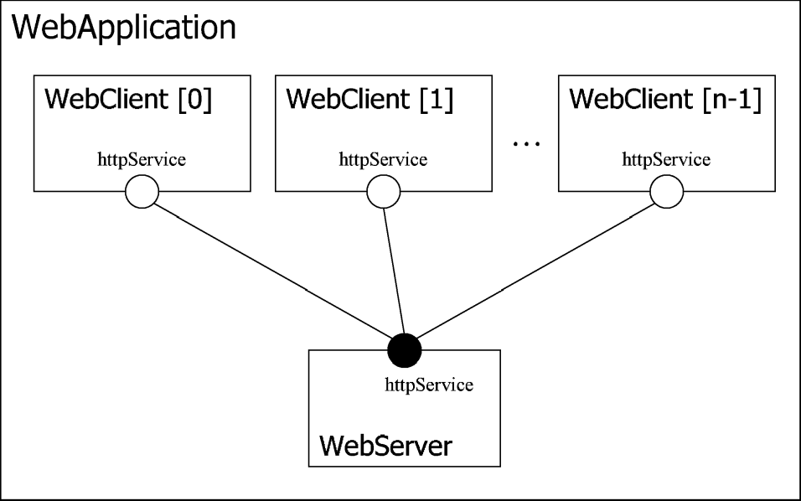
Programmatic Darwin Constructs
component WebServer{
provide httpService;
}
component WebClient{
require httpService;
}
component WebApplication(int numClients){
inst S: WebServer;
array C[numClients]: WebClient;
forall k:0..numClients-1{
inst C[k] @ k;
bind C[k].httpService -- S.httpService;
}
}
Software Architecture: Foundations, Theory, and Practice; Richard N. Taylor, Nenad Medvidovic, and Eric M. Dashofy; © 2008 John Wiley & Sons, Inc. Reprinted with permission.

Slide 8
Darwin Evaluation
Scope and purpose
  Modeling software structure
Basic elements
  Components, interfaces, configurations, hierarchy
Style
  Limited support through programmatic constructs
Static & Dynamic Aspects
  Mostly static structure; some additional support for dynamic aspects through lazy and dynamic instantiation/binding
Dynamic Models
  N/A
Non-Functional Aspects
  N/A
Ambiguity
  Rigorous, but structural elements can be interpreted in many ways
Accuracy
  Pi-calculus analysis
Precision
  Modelers choose appropriate level of detail through hierarchy
Viewpoints
  Structural viewpoints
Viewpoint consistency
  N/A

Slide 9
Rapide
Language and tool-set for exploring dynamic properties of systems of components that communicate through events
Advantages
  Unique and expressive language for describing asynchronously communicating components
  Tool-set supports simulation of models and graphical visualization of event traces
Disadvantages
  No natural or explicit mapping to implemented systems
  High learning curve
  Important tool support is difficult to run on modern machines
    Has morphed into the CEP project, however

Slide 10
Rapide Example
type DataStore is interface
action in SetValues();
out NotifyNewValues();
behavior
begin
SetValues => NotifyNewValues();;
end DataStore;
type Calculation is interface
action in SetBurnRate();
out DoSetValues();
behavior
action CalcNewState();
begin
SetBurnRate => CalcNewState(); DoSetValues();;
end Calculation;
type Player is interface
action out DoSetBurnRate();
in NotifyNewValues();
behavior
TurnsRemaining : var integer := 1;
action UpdateStatusDisplay();
action Done();
Software Architecture: Foundations, Theory, and Practice; Richard N. Taylor, Nenad Medvidovic, and Eric M. Dashofy; © 2008 John Wiley & Sons, Inc. Reprinted with permission.

Slide 11
Rapide Example (cont’d)
type DataStore is interface
action in SetValues();
out NotifyNewValues();
behavior
begin
SetValues => NotifyNewValues();;
end DataStore;
type Calculation is interface
action in SetBurnRate();
out DoSetValues();
behavior
action CalcNewState();
begin
SetBurnRate => CalcNewState(); DoSetValues();;
end Calculation;
type Player is interface
action out DoSetBurnRate();
in NotifyNewValues();
behavior
TurnsRemaining : var integer := 1;
action UpdateStatusDisplay();
action Done();
begin
(start or UpdateStatusDisplay) where \
($TurnsRemaining > 0) => \
if ( $TurnsRemaining > 0 ) then \
TurnsRemaining := $TurnsRemaining - 1; \
DoSetBurnRate(); \
end if;;
NotifyNewValues => UpdateStatusDisplay();;
UpdateStatusDisplay where $TurnsRemaining == 0 \
=> Done();;
end UserInterface;
architecture lander() is
P1, P2 : Player;
C : Calculation;
D : DataStore;
connect
P1.DoSetBurnRate to C.SetBurnRate;
P2.DoSetBurnRate to C.SetBurnRate;
C.DoSetValues to D.SetValues;
D.NotifyNewValues to P1.NotifyNewValues();
D.NotifyNewValues to P2.NotifyNewValues();
end LunarLander;
Software Architecture: Foundations, Theory, and Practice; Richard N. Taylor, Nenad Medvidovic, and Eric M. Dashofy; © 2008 John Wiley & Sons, Inc. Reprinted with permission.

Slide 12
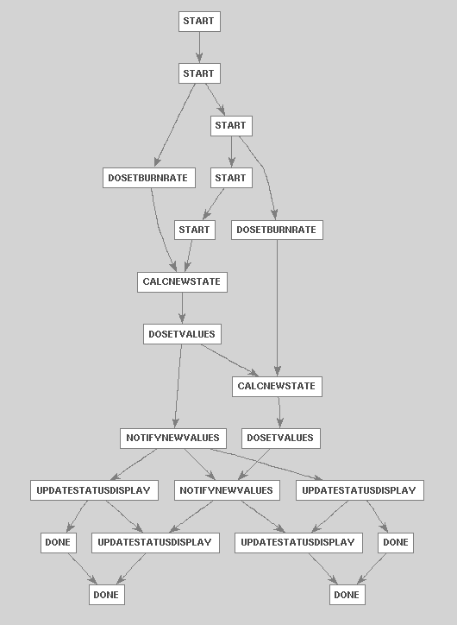
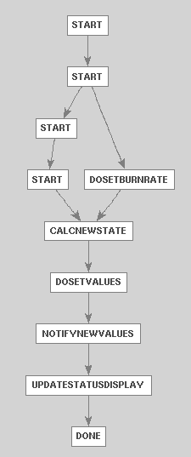
Simulation Output
1-player
2-player
Software Architecture: Foundations, Theory, and Practice; Richard N. Taylor, Nenad Medvidovic, and Eric M. Dashofy; © 2008 John Wiley & Sons, Inc. Reprinted with permission.

Slide 13
Rapide Evaluation
Ambiguity
  Well-defined semantics limit ambiguity
Accuracy
  Compilers check syntax, simulators can be used to check semantics although simulation results are non-deterministic and non-exhaustive
Precision
  Detailed behavioral modeling possible
Viewpoints
  Single structural/behavioral viewpoint
Viewpoint consistency
  N/A
Scope and purpose
  Interactions between components communicating with events
Basic elements
  Structures, components/ interfaces, behaviors
Style
  N/A
Static & Dynamic Aspects
  Static structure and dynamic behavior co-modeled
Dynamic Models
  Some tools provide limited animation capabilities
Non-Functional Aspects
  N/A

Slide 14
Wright
An ADL that specifies structure and formal behavioral specifications for interfaces between components and connectors
Advantages
  Structural specification similar to Darwin or Rapide
  Formal interface specifications can be translated automatically into CSP and analyzed with tools
    Can detect subtle problems e.g., deadlock
Disadvantages
  High learning curve
  No direct mapping to implemented systems
  Addresses a small number of system properties relative to cost of use

Slide 15


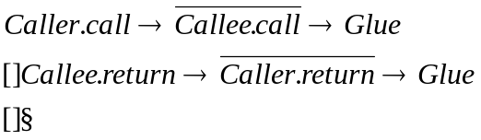
Wright Example
Component DataStore
Port getValues (behavior specification)
Port storeValues (behavior specification)
Computation (behavior specification)
Component Calculation
Port getValues (behavior specification)
Port storeValues (behavior specification)
Port calculate (behavior specification)
Computation (behavior specification)
Component UserInterface
Port getValues (behavior specification)
Port calculate (behavior specification)
Computation (behavior specification)
Connector Call
Role Caller =
Role Callee =
Glue =
Software Architecture: Foundations, Theory, and Practice; Richard N. Taylor, Nenad Medvidovic, and Eric M. Dashofy; © 2008 John Wiley & Sons, Inc. Reprinted with permission.

Slide 16
Wright Example
Component DataStore
Port getValues (behavior specification)
Port storeValues (behavior specification)
Computation (behavior specification)
Component Calculation
Port getValues (behavior specification)
Port storeValues (behavior specification)
Port calculate (behavior specification)
Computation (behavior specification)
Component UserInterface
Port getValues (behavior specification)
Port calculate (behavior specification)
Computation (behavior specification)
Connector Call
Role Caller =
Role Callee =
Glue =
Configuration LunarLander
Instances
DS : DataStore
C : Calculation
UI : UserInterface
CtoUIgetValues, CtoUIstoreValues, UItoC, UItoDS : Call
Attachments
C.getValues as CtoUIgetValues.Caller
DS.getValues as CtoUIgetValues.Callee
C.storeValues as CtoUIstoreValues.Caller
DS.storeValues as CtoUIstoreValues.Callee
UI.calculate as UItoC.Caller
C.calulate as UItoC.Callee
UI.getValues as UItoDS.Caller
DS.getValues as UItoDS.Callee
End LunarLander.
Software Architecture: Foundations, Theory, and Practice; Richard N. Taylor, Nenad Medvidovic, and Eric M. Dashofy; © 2008 John Wiley & Sons, Inc. Reprinted with permission.

Slide 17
Wright Evaluation
Scope and purpose
  Structures, behaviors, and styles of systems composed of components & connectors
Basic elements
  Components, connectors, interfaces, attachments, styles
Style
  Supported through predicates over instance models
Static & Dynamic Aspects
  Static structural models annotated with behavioral specifications
Dynamic Models
  N/A
Non-Functional Aspects
  N/A
Ambiguity
  Well-defined semantics limit ambiguity
Accuracy
  Wright models can be translated into CSP for automated analysis
Precision
  Detailed behavioral modeling possible
Viewpoints
  Single structural/behavioral viewpoint plus styles
Viewpoint consistency
  Style checking can be done automatically

Slide 18
Domain- and Style-Specific ADLs
Notations we have surveyed thus far have been generically applicable to many types of software systems
If you restrict the target domain, you can provide more advanced features and/or reduce complexity
  We’ll talk a lot more about domain-specific software engineering later in the course

Slide 19
Koala
Darwin-inspired notation for specifying product lines of embedded consumer-electronics devices
Advantages
  Advanced product-line features let you specify many systems in a single model
  Direct mapping to implemented systems promotes design and code reuse
Disadvantages
  Limited to structural specification with additional focus on interfaces

Slide 20
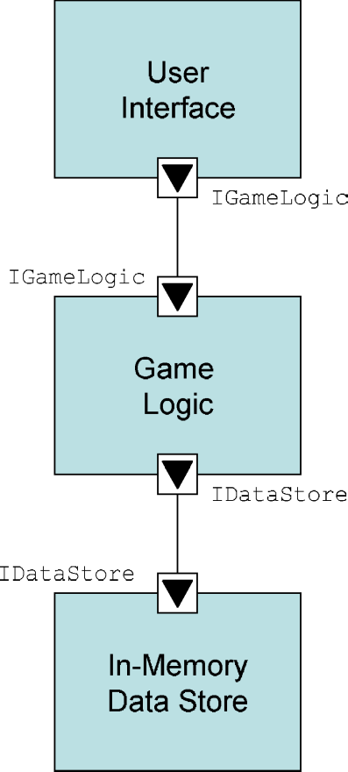
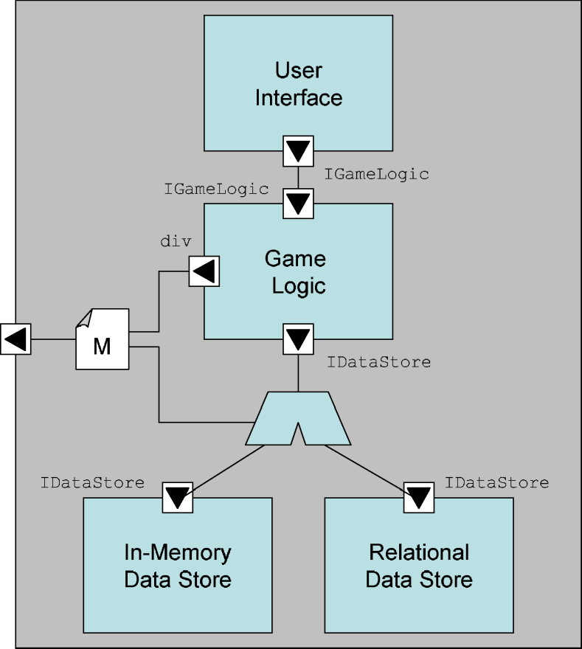
Koala Example
interface IDataStore{
void setAltitude(int altitudeInMeters);
int getAltitude();
void setBurnRate(int newBurnRate);
int getBurnRate();
...
}
Single system
Product line of two systems
Software Architecture: Foundations, Theory, and Practice; Richard N. Taylor, Nenad Medvidovic, and Eric M. Dashofy; © 2008 John Wiley & Sons, Inc. Reprinted with permission.

Slide 21
Koala Evaluation
Scope and purpose
  Structures and interfaces of product lines of component-based systems
Basic elements
  Components, interfaces, elements for variation points: switches, diversity interfaces, etc.
Style
  Product lines might be seen as very narrow styles
Static & Dynamic Aspects
  Static structure only
Dynamic Models
  N/A
Non-Functional Aspects
  N/A
Ambiguity
  Close mappings to implementation limit ambiguity
Accuracy
  Close mappings to implementations should reveal problems
Precision
  Structural decisions are fully enumerated but other aspects left out
Viewpoints
  Structural viewpoint with explicit points of variation
Viewpoint consistency
  N/A

Slide 22
Weaves
An architectural style and notation for modeling systems of small-grain tool fragments that communicate through data flows of objects
Advantages
  Extremely optimized notation
    Even simpler than Darwin diagrams
  Close mapping to implemented systems
Disadvantages
  Addresses structure and data flows only

Slide 23
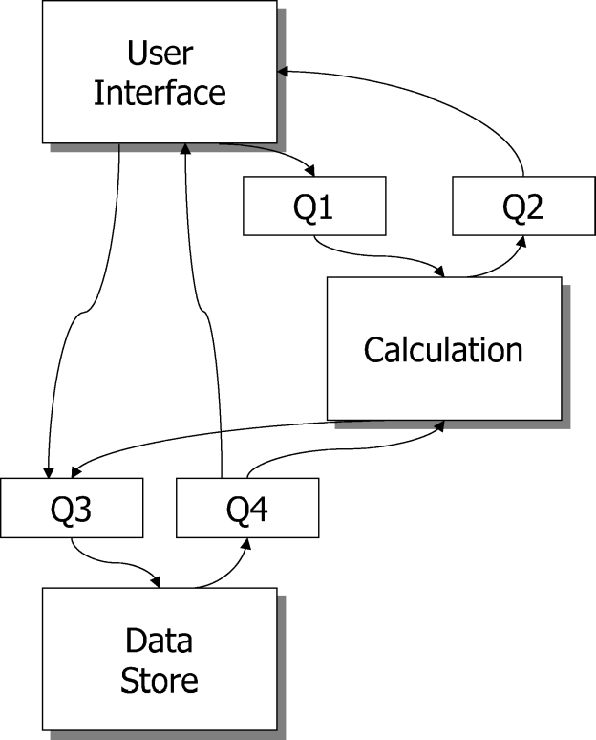
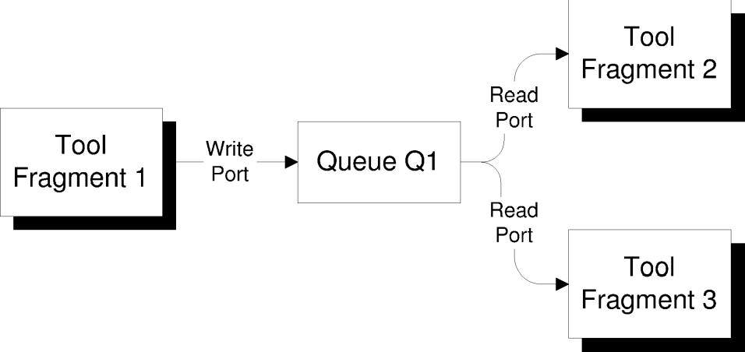
Weaves Example
Generic Weaves
System
Lunar Lander in
Weaves
Software Architecture: Foundations, Theory, and Practice; Richard N. Taylor, Nenad Medvidovic, and Eric M. Dashofy; © 2008 John Wiley & Sons, Inc. Reprinted with permission.

Slide 24
Augmenting Weaves
Weaves diagrams do not capture the protocol or kinds of data that flow across component boundaries
This could be rectified through, for example, additional natural language or more formal (e.g., CSP) protocol specifications
The connection from User Interface to Calculation (via Q1) carries objects that include a burn-rate and instruct the calculation component to calculate a new Lander state.
The connection from Calculation to User Interface (via Q2) indicates when the calculation is complete and also includes the termination state of the application.
The connections from User Interface and Calculation to Data Store (via Q3) carry objects that either update or query the state of the Lander.
The connections back to User Interface and Calculation from Data Store (via Q4) carry objects that contain the Lander state, and are sent out whenever the state of the Lander is updated.

Slide 25
Weaves Evaluation
Scope and purpose
  Structures of components and connectors in the Weaves style
Basic elements
  Components, queues, directed interconnections
Style
  Weaves style implicit
Static & Dynamic Aspects
  Static structure only
Dynamic Models
  N/A, although there is a 1-1 correspondence between model and implementation elements
Non-Functional Aspects
  N/A
Ambiguity
  Meanings of Weaves elements are well-defined although important elements (e.g., protocols) are subject to interpretation
Accuracy
  Syntactic (e.g., structural) errors easy to identify
Precision
  Structural decisions are fully enumerated but other aspects left out
Viewpoints
  Structural viewpoint
Viewpoint consistency
  N/A

Slide 26
AADL: The Architecture Analysis & Design Language
Notation and tool-set for modeling hardware/software systems, particularly embedded and real-time systems
Advantages
  Allows detailed specification of both hardware and software aspects of a system
  Automated analysis tools check interesting end-to-end properties of system
Disadvantages
  Verbose; large amount of detail required to capture even simple systems
  Emerging tool support and UML profile support

Slide 27
AADL (Partial) Example
data lander_state_data
end lander_state_data;
bus lan_bus_type
end lan_bus_type;
bus implementation lan_bus_type.ethernet
properties
Transmission_Time => 1 ms .. 5 ms;
Allowed_Message_Size => 1 b .. 1 kb;
end lan_bus_type.ethernet;
system calculation_type
features
network : requires bus access
lan_bus.calculation_to_datastore;
request_get : out event port;
response_get : in event data port lander_state_data;
request_store : out event port lander_state_data;
response_store : in event port;
end calculation_type;
system implementation calculation_type.calculation
subcomponents
the_calculation_processor :
processor calculation_processor_type;
the_calculation_process : process
calculation_process_type.one_thread;
Software Architecture: Foundations, Theory, and Practice; Richard N. Taylor, Nenad Medvidovic, and Eric M. Dashofy; © 2008 John Wiley & Sons, Inc. Reprinted with permission.

Slide 28
AADL (Partial) Example
data lander_state_data
end lander_state_data;
bus lan_bus_type
end lan_bus_type;
bus implementation lan_bus_type.ethernet
properties
Transmission_Time => 1 ms .. 5 ms;
Allowed_Message_Size => 1 b .. 1 kb;
end lan_bus_type.ethernet;
system calculation_type
features
network : requires bus access
lan_bus.calculation_to_datastore;
request_get : out event port;
response_get : in event data port lander_state_data;
request_store : out event port lander_state_data;
response_store : in event port;
end calculation_type;
system implementation calculation_type.calculation
subcomponents
the_calculation_processor :
processor calculation_processor_type;
the_calculation_process : process
calculation_process_type.one_thread;
connections
bus access network -> the_calculation_processor.network;
event data port response_get ->
the_calculation_process.response_get;
event port the_calculation_process.request_get ->
request_get;
event data port response_store ->
the_calculation_process.response_store;
properties
Actual_Processor_Binding => reference
the_calculation_processor applies to
the_calculation_process;
end calculation_type.calculation;
processor calculation_processor_type
features
network : requires bus access
lan_bus.calculation_to_datastore;
end calculation_processor_type;
process calculation_process_type
features
request_get : out event port;
response_get : in event data port lander_state_data;
request_store : out event data port lander_state_data;
response_store : in event port;
end calculation_process_type;
Software Architecture: Foundations, Theory, and Practice; Richard N. Taylor, Nenad Medvidovic, and Eric M. Dashofy; © 2008 John Wiley & Sons, Inc. Reprinted with permission.

Slide 29
AADL (Partial) Example
data lander_state_data
end lander_state_data;
bus lan_bus_type
end lan_bus_type;
bus implementation lan_bus_type.ethernet
properties
Transmission_Time => 1 ms .. 5 ms;
Allowed_Message_Size => 1 b .. 1 kb;
end lan_bus_type.ethernet;
system calculation_type
features
network : requires bus access
lan_bus.calculation_to_datastore;
request_get : out event port;
response_get : in event data port lander_state_data;
request_store : out event port lander_state_data;
response_store : in event port;
end calculation_type;
system implementation calculation_type.calculation
subcomponents
the_calculation_processor :
processor calculation_processor_type;
the_calculation_process : process
calculation_process_type.one_thread;
connections
bus access network -> the_calculation_processor.network;
event data port response_get ->
the_calculation_process.response_get;
event port the_calculation_process.request_get ->
request_get;
event data port response_store ->
the_calculation_process.response_store;
properties
Actual_Processor_Binding => reference
the_calculation_processor applies to
the_calculation_process;
end calculation_type.calculation;
processor calculation_processor_type
features
network : requires bus access
lan_bus.calculation_to_datastore;
end calculation_processor_type;
process calculation_process_type
features
request_get : out event port;
response_get : in event data port lander_state_data;
request_store : out event data port lander_state_data;
response_store : in event port;
end calculation_process_type;
thread calculation_thread_type
features
request_get : out event port;
response_get : in event data port lander_state_data;
request_store : out event data port lander_state_data;
response_store : in event port;
properties
Dispatch_Protocol => periodic;
end calculation_thread_type;
process implementation calculation_process_type.one_thread
subcomponents
calculation_thread : thread client_thread_type;
connections
event data port response_get ->
calculation_thread.response_get;
event port calculation_thread.request_get -> request_get;
event port response_store ->
calculation_thread.response_store;
event data port request_store -> request_store;
properties
Dispatch_Protocol => Periodic;
Period => 20 ms;
end calculation_process_type.one_thread;
Software Architecture: Foundations, Theory, and Practice; Richard N. Taylor, Nenad Medvidovic, and Eric M. Dashofy; © 2008 John Wiley & Sons, Inc. Reprinted with permission.

Slide 30
AADL Example Explained a Bit
Note the level of detail at which the system is specified
  A component (calculation_type.calculation) runs on…
  a physical processor (the_calculation_processor), which runs…
  a process (calculation_process_type.one_thread), which in turn contains…
  a single thread of control (calculation_thread), all of which can make two kinds of request-response calls through…
  ports (request_get/response_get, request_store/response_store) over…
  an Ethernet bus (lan_bus_type.Ethernet).
All connected through composition, port-mapping, and so on
This detail is what gives AADL its power and analyzability

Slide 31
AADL Evaluation
Scope and purpose
  Interconnected multi-level systems architectures
Basic elements
  Multitude – components, threads, hardware elements, configurations, mappings…
Style
  N/A
Static & Dynamic Aspects
  Primarily static structure but additional properties specify dynamic aspects
Dynamic Models
  N/A
Non-Functional Aspects
  N/A
Ambiguity
  Most elements have concrete counterparts with well-known semantics
Accuracy
  Structural as well as other interesting properties can be automatically analyzed
Precision
  Many complex interconnected levels of abstraction and concerns
Viewpoints
  Many viewpoints addressing different aspects of the system
Viewpoint consistency
  Mappings and refinement can generally be automatically checked or do not overlap

Slide 32
Extensible ADLs
There is a tension between
  The expressiveness of general-purpose ADLs and
  The optimization and customization of more specialized ADLs
How do we get the best of both worlds?
  Use multiple notations in tandem
    (Difficult to keep consistent, often means excessive redundancy)
  Overload an existing notation or ADL (e.g., UML profiles)
    Increases confusion, doesn’t work well if the custom features don’t map naturally onto existing features
  Add additional features we want to an existing ADL
    But existing ADLs provide little or no guidance for this
Extensible ADLs attempt to provide such guidance

Slide 33
Acme
Early general purpose ADL with support for extensibility through properties
Advantages
  Structural specification capabilities similar to Darwin
  Simple property structure allows for arbitrary decoration of existing elements
  Tool support with AcmeStudio
Disadvantages
  No way to add new views
  Property specifications can become extremely complex and have entirely separate syntax/semantics of their own

Slide 34
Acme Example
//Global Types
Property Type returnsValueType = bool;
Connector Type CallType = {
Roles { callerRole; calleeRole; };
Property returnsValue : returnsValueType;
};
System LunarLander = {
//Components
Component DataStore = {
Ports { getValues; storeValues; }
};
Component Calculation = {
Ports { calculate; getValues; storeValues; }
};
Component UserInterface = {
Ports { getValues; calculate; }
};
// Connectors
Connector UserInterfaceToCalculation : CallType {
Roles { callerRole; calleeRole; };
Property returnsValue : returnsValueType = true;
}
Connector UserInterfaceToDataStore : CallType {
Roles { callerRole; calleeRole; };
Property returnsValue : returnsValueType = true;
}
Software Architecture: Foundations, Theory, and Practice; Richard N. Taylor, Nenad Medvidovic, and Eric M. Dashofy; © 2008 John Wiley & Sons, Inc. Reprinted with permission.

Slide 35
Acme Example
Connector CalculationToDataStoreS : CallType {
Roles { callerRole; calleeRole; };
Property returnsValue : returnsValueType = false;
}
Connector CalculationToDataStoreG : CallType {
Roles { callerRole; calleeRole; };
Property returnsValue : returnsValueType = true;
}
Attachments {
UserInterface.getValues to
UserInterfaceToDataStore.callerRole;
UserInterfaceToDataStore.calleeRole to
DataStore.getValues;
UserInterface.getValues to
UserInterfaceToDataStore.callerRole;
UserInterfaceToDataStore.calleeRole to
DataStore.getValues;
UserInterface.calculate to
UserInterfaceToCalculation.callerRole;
UserInterfaceToCalculation.calleeRole to
Calculation.calculate;
Calculation.storeValues to
CalculationToDataStoreS.callerRole;
CalculationToDataStoreS.calleeRole to
DataStore.storeValues;
Calculation.getValues to
CalculationToDataStoreG.callerRole;
CalculationToDataStoreG.calleeRole to
DataStore.getValues;
};
}
//Global Types
Property Type returnsValueType = bool;
Connector Type CallType = {
Roles { callerRole; calleeRole; };
Property returnsValue : returnsValueType;
};
System LunarLander = {
//Components
Component DataStore = {
Ports { getValues; storeValues; }
};
Component Calculation = {
Ports { calculate; getValues; storeValues; }
};
Component UserInterface = {
Ports { getValues; calculate; }
};
// Connectors
Connector UserInterfaceToCalculation : CallType {
Roles { callerRole; calleeRole; };
Property returnsValue : returnsValueType = true;
}
Connector UserInterfaceToDataStore : CallType {
Roles { callerRole; calleeRole; };
Property returnsValue : returnsValueType = true;
}
Software Architecture: Foundations, Theory, and Practice; Richard N. Taylor, Nenad Medvidovic, and Eric M. Dashofy; © 2008 John Wiley & Sons, Inc. Reprinted with permission.

Slide 36
Acme Extensions
Connector CalculationToDataStoreS : CallType {
Roles { callerRole; calleeRole; };
Property returnsValue : returnsValueType = false;
}
Connector CalculationToDataStoreG : CallType {
Roles { callerRole; calleeRole; };
Property returnsValue : returnsValueType = true;
}
Attachments {
UserInterface.getValues to
UserInterfaceToDataStore.callerRole;
UserInterfaceToDataStore.calleeRole to
DataStore.getValues;
UserInterface.getValues to
UserInterfaceToDataStore.callerRole;
UserInterfaceToDataStore.calleeRole to
DataStore.getValues;
UserInterface.calculate to
UserInterfaceToCalculation.callerRole;
UserInterfaceToCalculation.calleeRole to
Calculation.calculate;
Calculation.storeValues to
CalculationToDataStoreS.callerRole;
CalculationToDataStoreS.calleeRole to
DataStore.storeValues;
Calculation.getValues to
CalculationToDataStoreG.callerRole;
CalculationToDataStoreG.calleeRole to
DataStore.getValues;
};
}
//Global Types
Property Type returnsValueType = bool;
Connector Type CallType = {
Roles { callerRole; calleeRole; };
Property returnsValue : returnsValueType;
};
System LunarLander = {
//Components
Component DataStore = {
Ports { getValues; storeValues; }
};
Component Calculation = {
Ports { calculate; getValues; storeValues; }
};
Component UserInterface = {
Ports { getValues; calculate; }
};
// Connectors
Connector UserInterfaceToCalculation : CallType {
Roles { callerRole; calleeRole; };
Property returnsValue : returnsValueType = true;
}
Connector UserInterfaceToDataStore : CallType {
Roles { callerRole; calleeRole; };
Property returnsValue : returnsValueType = true;
}
Property Type StoreType = enum { file,
relationalDatabase, objectDatabase };
Component DataStore = {
Ports {
getValues; storeValues;
}
Property storeType : StoreType =
relationalDatabase;
Property tableName : String = “LanderTable”;
Property numReplicas: int = 0;
};
Software Architecture: Foundations, Theory, and Practice; Richard N. Taylor, Nenad Medvidovic, and Eric M. Dashofy; © 2008 John Wiley & Sons, Inc. Reprinted with permission.

Slide 37
Acme Evaluation
Scope and purpose
  Structures of components and connectors with extensible properties
Basic elements
  Components, connectors, interfaces, hierarchy, properties
Style
  Through type system
Static & Dynamic Aspects
  Static structure is modeled natively, dynamic aspects in properties
Dynamic Models
  AcmeLib allows programmatic model manipulation
Non-Functional Aspects
  Through properties
Ambiguity
  Meanings of elements subject to some interpretation, properties may have arbitrary level of rigor/formality
Accuracy
  Checkable syntactically, via type system, and properties by external tools
Precision
  Properties can increase precision but cannot add new elements
Viewpoints
  Structural viewpoint is native, properties might provide additional viewpoints
Viewpoint consistency
  Via external tools that must be developed

Slide 38
ADML
Effort to standardize the concepts in Acme and leverage XML as a syntactic base
Advantages
  XML parsers and tools readily available
  Added some ability to reason about types of properties with meta-properties
Disadvantages
  Properties are still name-value pairs
  Did not take advantage of XML extension mechanisms

Slide 39
ADML Example
Similar to Acme, except in an XML format
<Component ID=”datastore” name=”Data Store”>
<ComponentDescription>
<ComponentBody>
<Port ID=”getValues” name=”getValues”/>
<Port ID=”storeValues” name=”storeValues”/>
</ComponentBody>
</ComponentDescription>
</Component>
Software Architecture: Foundations, Theory, and Practice; Richard N. Taylor, Nenad Medvidovic, and Eric M. Dashofy; © 2008 John Wiley & Sons, Inc. Reprinted with permission.

Slide 40
xADL
Modular XML-based ADL intended to maximize extensibility both in notation and tools
Advantages
  Growing set of generically useful modules available already
  Tool support in ArchStudio environment
  Users can add their own modules via well-defined extensibility mechanisms
Disadvantages
  Extensibility mechanisms can be complex and increase learning curve
  Heavy reliance on tools

Slide 41
xADL Example
<types:component xsi:type="types:Component"
types:id="myComp">
<types:description xsi:type="instance:Description">
MyComponent
</types:description>
<types:interface xsi:type="types:Interface"
types:id="iface1">
<types:description xsi:type="instance:Description">
Interface1
</types:description>
<types:direction xsi:type="instance:Direction">
inout
</types:direction>
</types:interface>
</types:component>
Software Architecture: Foundations, Theory, and Practice; Richard N. Taylor, Nenad Medvidovic, and Eric M. Dashofy; © 2008 John Wiley & Sons, Inc. Reprinted with permission.

Slide 42
xADL Example
<types:component xsi:type="types:Component"
types:id="myComp">
<types:description xsi:type="instance:Description">
MyComponent
</types:description>
<types:interface xsi:type="types:Interface"
types:id="iface1">
<types:description xsi:type="instance:Description">
Interface1
</types:description>
<types:direction xsi:type="instance:Direction">
inout
</types:direction>
</types:interface>
</types:component>
component{
id = "myComp";
description = "MyComponent";
interface{
id = "iface1";
description = "Interface1";
direction = "inout";
}
}
Software Architecture: Foundations, Theory, and Practice; Richard N. Taylor, Nenad Medvidovic, and Eric M. Dashofy; © 2008 John Wiley & Sons, Inc. Reprinted with permission.

Slide 43
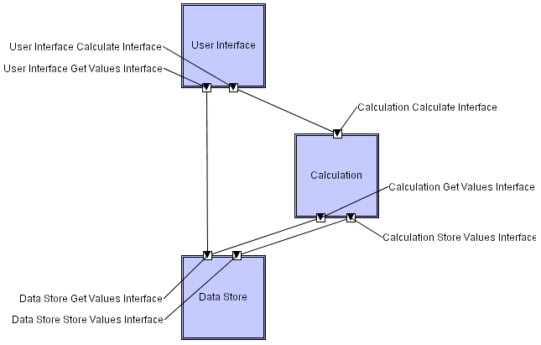
xADL Example
<types:component xsi:type="types:Component"
types:id="myComp">
<types:description xsi:type="instance:Description">
MyComponent
</types:description>
<types:interface xsi:type="types:Interface"
types:id="iface1">
<types:description xsi:type="instance:Description">
Interface1
</types:description>
<types:direction xsi:type="instance:Direction">
inout
</types:direction>
</types:interface>
</types:component>
component{
id = "myComp";
description = "MyComponent";
interface{
id = "iface1";
description = "Interface1";
direction = "inout";
}
}
Software Architecture: Foundations, Theory, and Practice; Richard N. Taylor, Nenad Medvidovic, and Eric M. Dashofy; © 2008 John Wiley & Sons, Inc. Reprinted with permission.

Slide 44
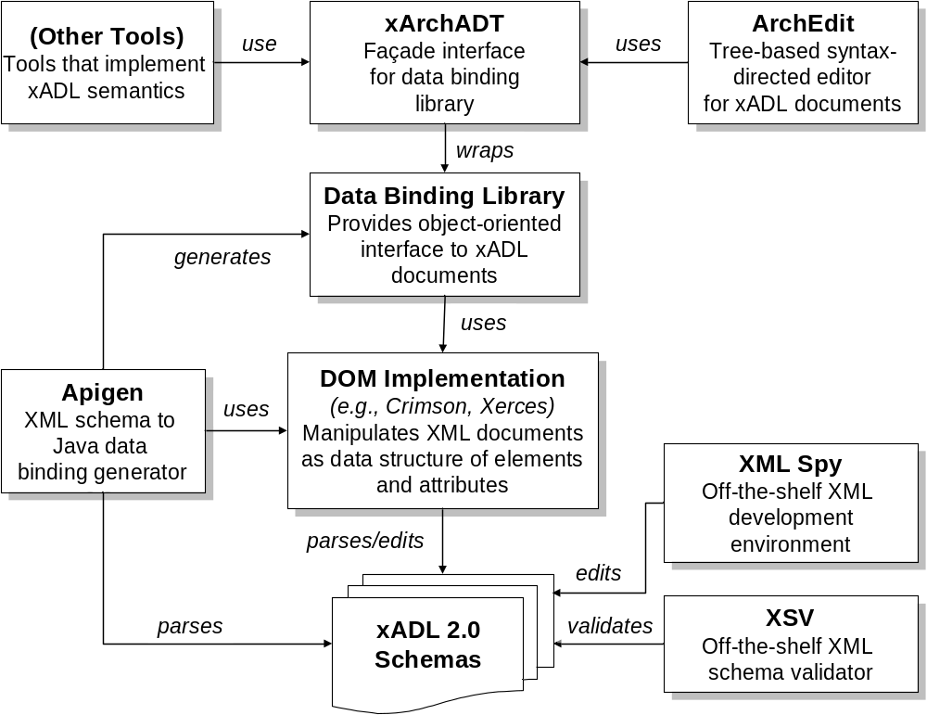
xADL Tools
Software Architecture: Foundations, Theory, and Practice; Richard N. Taylor, Nenad Medvidovic, and Eric M. Dashofy; © 2008 John Wiley & Sons, Inc. Reprinted with permission.

Slide 45
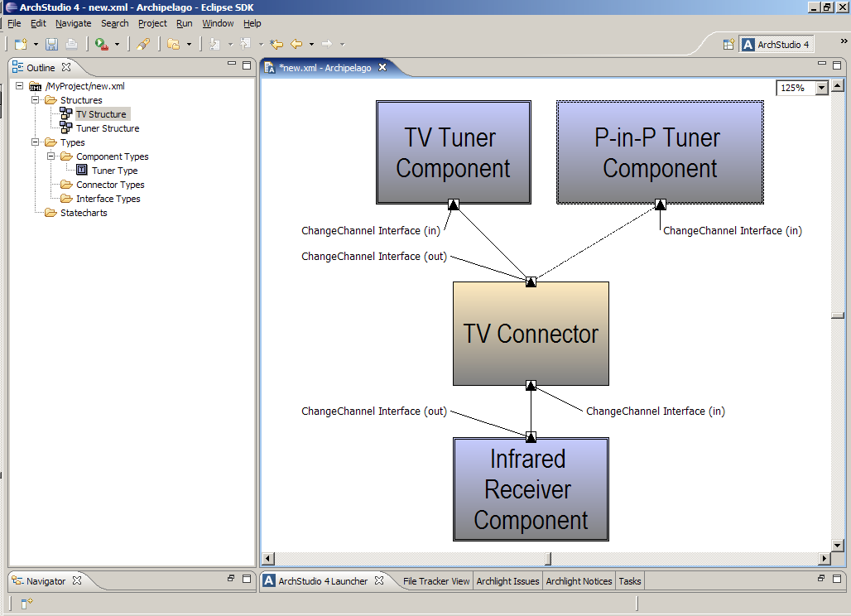
ArchStudio Environment
Software Architecture: Foundations, Theory, and Practice; Richard N. Taylor, Nenad Medvidovic, and Eric M. Dashofy; © 2008 John Wiley & Sons, Inc. Reprinted with permission.

Slide 46
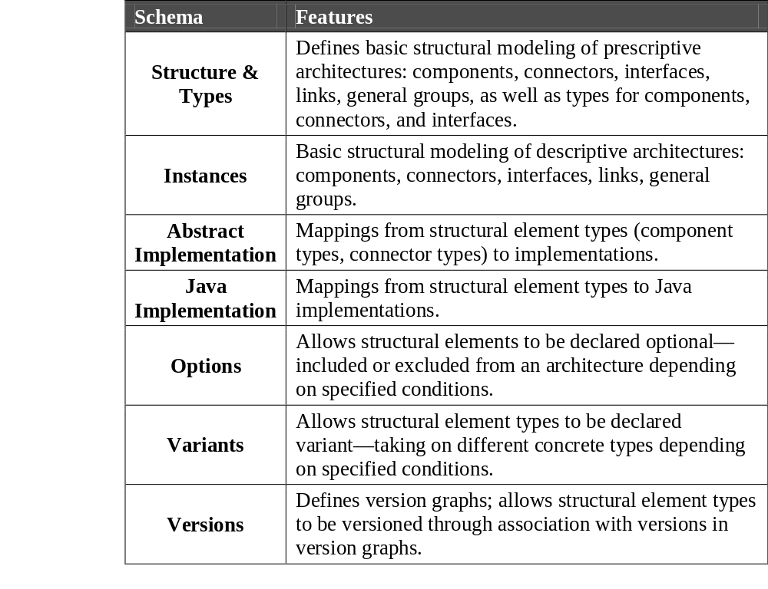
xADL Schemas (Modules)
Software Architecture: Foundations, Theory, and Practice; Richard N. Taylor, Nenad Medvidovic, and Eric M. Dashofy; © 2008 John Wiley & Sons, Inc. Reprinted with permission.

Slide 47
xADL Evaluation
Scope and purpose
  Modeling various architectural concerns with explicit focus on extensibility
Basic elements
  Components, connectors, interfaces, links, options, variants, versions, …, plus extensions
Style
  Limited, through type system
Static & Dynamic Aspects
  Mostly static views with behavior and dynamic aspects provided through extensions
Dynamic Models
  Models can be manipulated programmatically
Non-Functional Aspects
  Through extensions
Ambiguity
  Base schemas are permissive; extensions add rigor or formality if needed
Accuracy
  Correctness checkers included in ArchStudio and users can add additional tools through well-defined mechanisms
Precision
  Base schemas are abstract, precision added in extensions
Viewpoints
  Several viewpoints provided natively, new viewpoints through extensions
Viewpoint consistency
  Checkable through external tools and additional consistency rules

Slide 48
Caveat 1
The preceding overview optimized for breadth rather than depth
  Semantics and capabilities of many of these notations quite deep and subtle
    Some even have entire books written about them
  You are encouraged to investigate individual notations more deeply

Slide 49
Caveat 2
Some systems are difficult to model in traditional ways
  ‘Agile’ systems that are not explicitly designed above the level of code modules
  Extremely large, complex, or dynamic systems (e.g., the Web)
    Can model limited or less complex aspects
    Can model one instance of the system (e.g., one Web application)
    Exploit regularity
    Model the style
    Model the protocols

